Slide 1
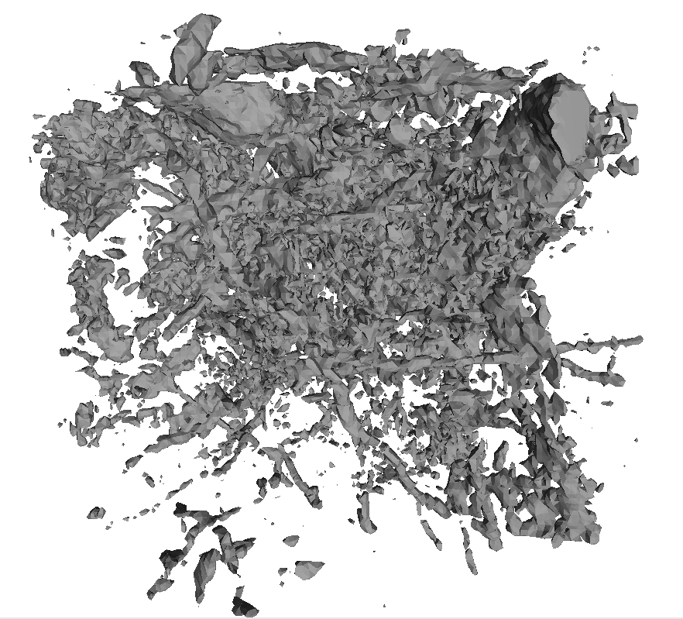
MONet Community Science Meeting – X-ray Computed Tomography (XCT) Hands-On Tutorial
Tamas Varga
Maruti Mudunuru
Anil K. Battu
November 8, 2023

Slide 2
Things to do before the meeting
Download and install Fiji (ImageJ), make sure it works: try opening “Soil core 2 top zoom_500x500x500_8b”, see slides 4-7 for help
Download files “Soil core 2 top zoom_500x500x500_8b”, “Binary image_500x500x500_8bit”, “Classified image_500x500x500_RGB”, “Pores.stl” and “Example soil porosity data.xlsx”
Download ParaView: https://www.paraview.org/download/

Slide 3
Outline
Processing and segmentation of 3D data in Fiji (ImageJ)
Basic porosity analysis: pore size distribution
Example for easy visualization of 3D data
XCT data analysis and visualization needed for PFLOTRAN modeling
Google Colab notebook
3D visualization using ParaView

Slide 4
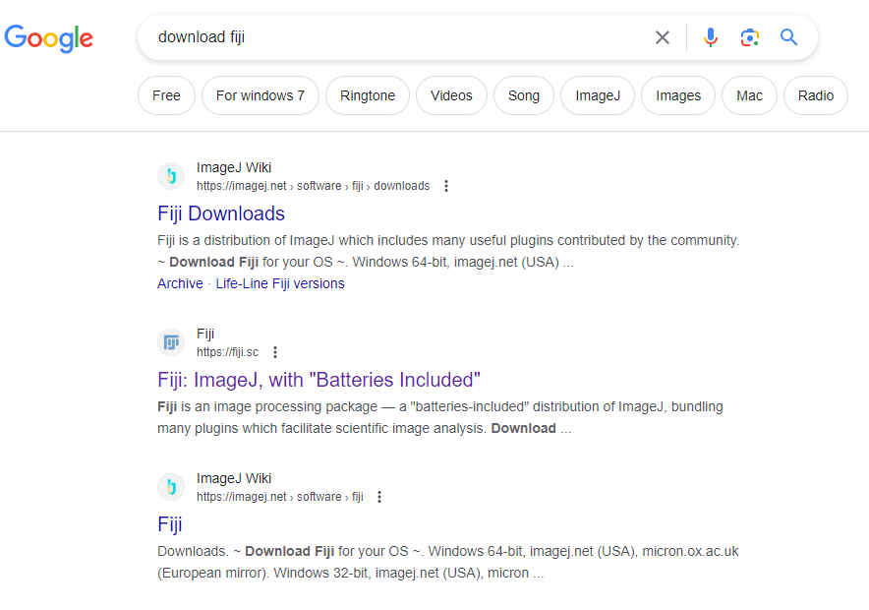
Download Fiji

Slide 5
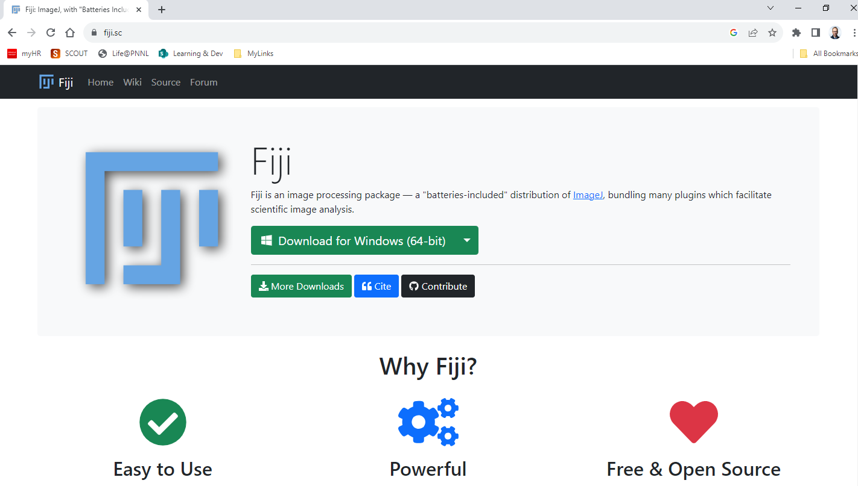
Install Fiji

Slide 6
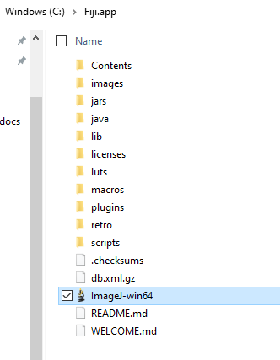
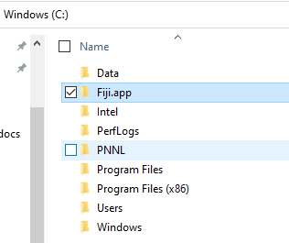
Install Fiji – cont.
Copy Fiji.app folder from zip file to C drive
Run application file “ImageJ-win64”
Allow for Java installation as offered (if you do not already run Java 1.8)
Once app started, run updater
You can pin this application file to taskbar for easy access

Slide 7
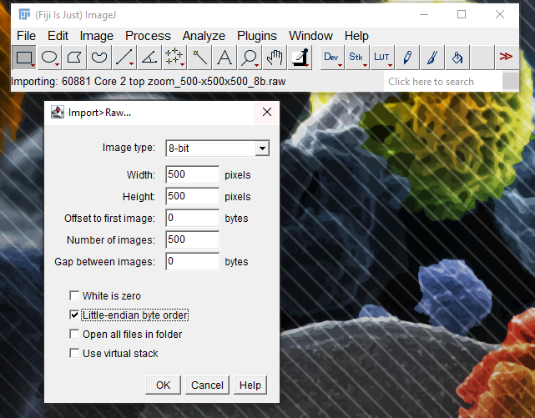
Import data: Soil core 2 top zoom_500x500x500_8b.raw

Slide 8
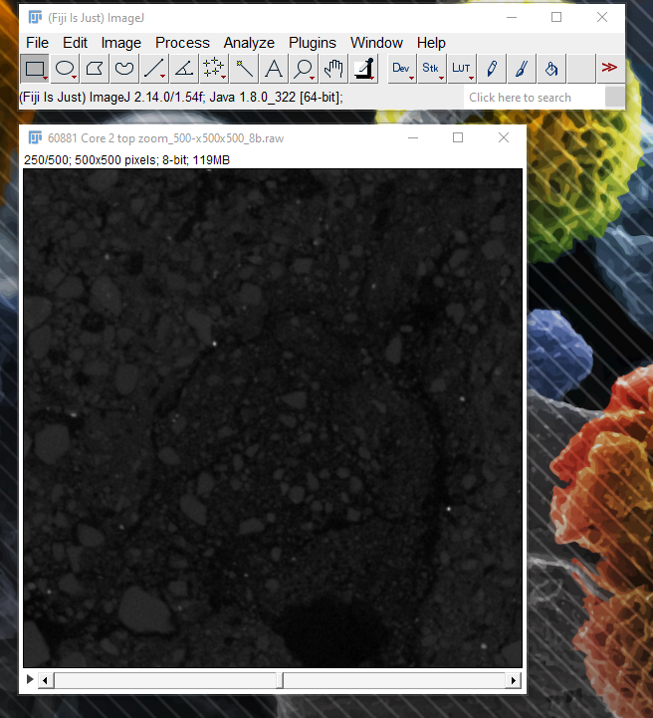
Import data – cont.

Slide 9
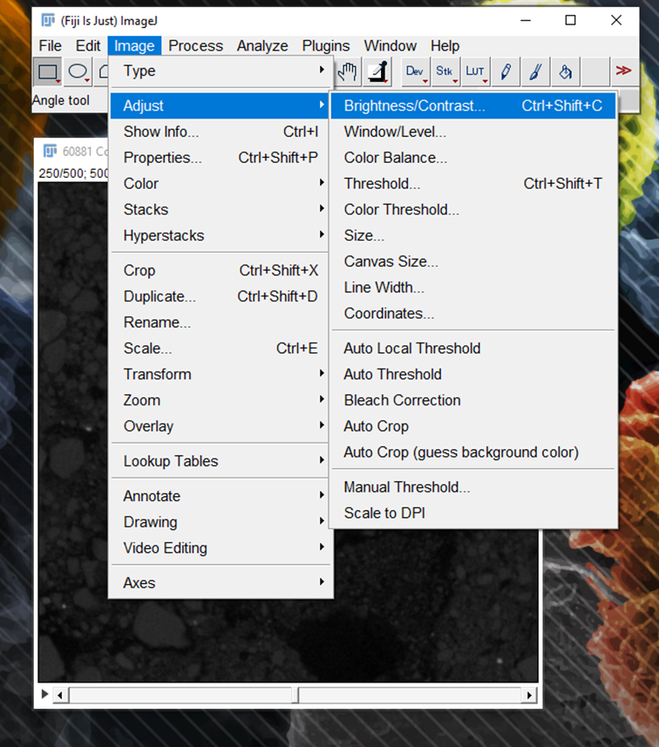
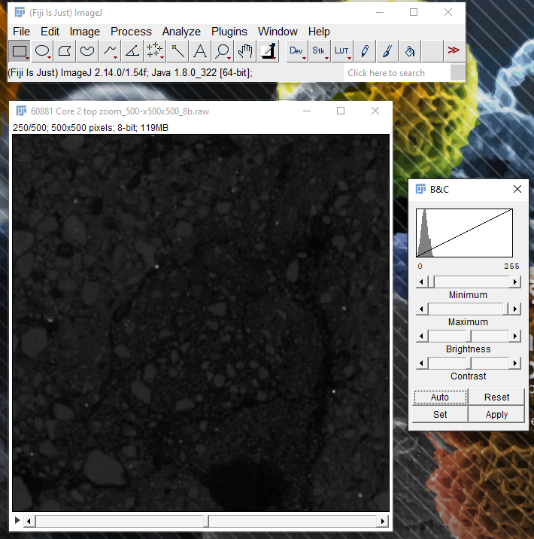
Enhance image contrast

Slide 10
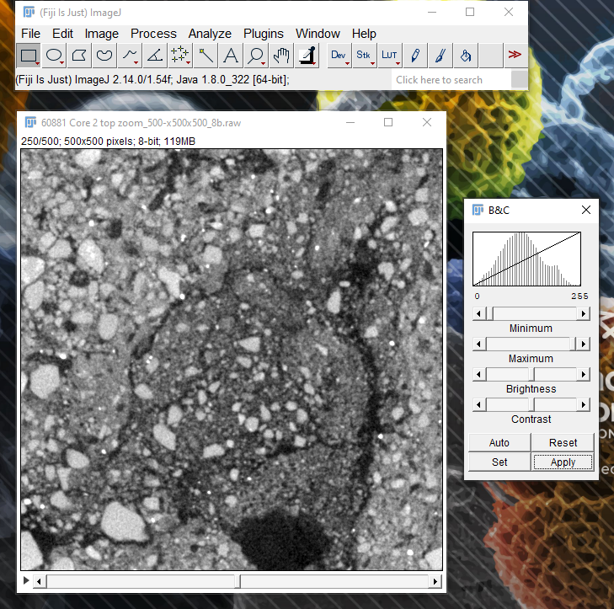
Enhance image contrast – cont.

Slide 11
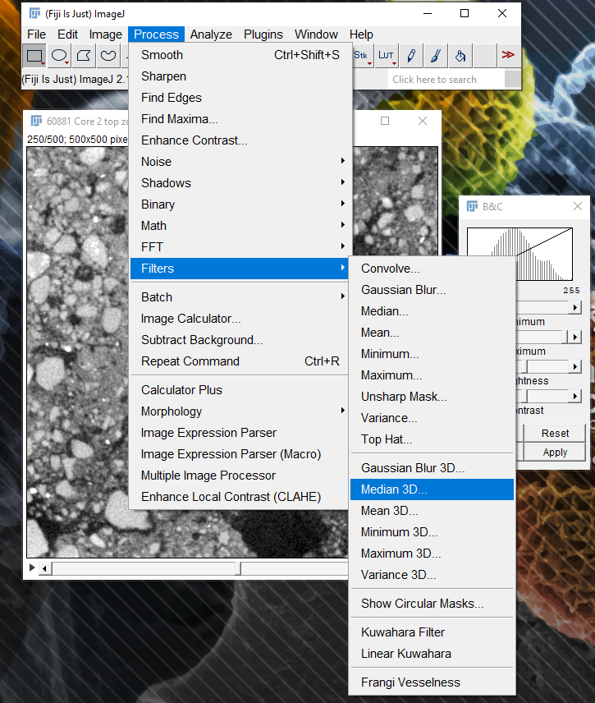
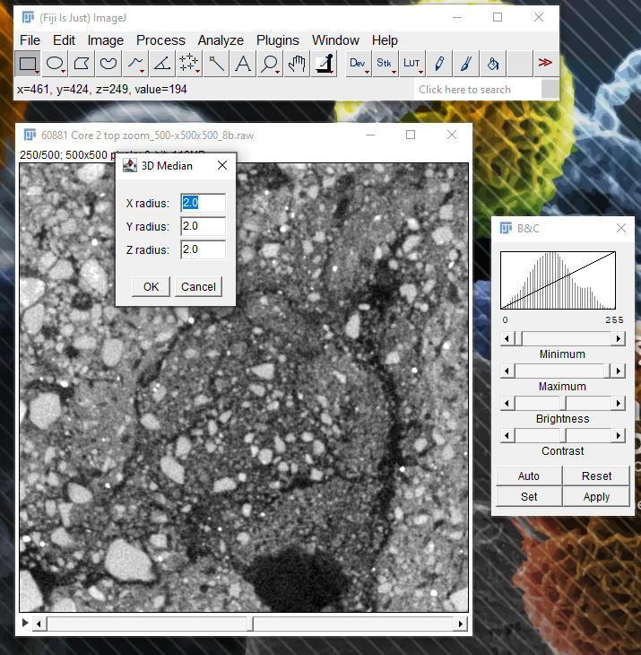
Filtering

Slide 12
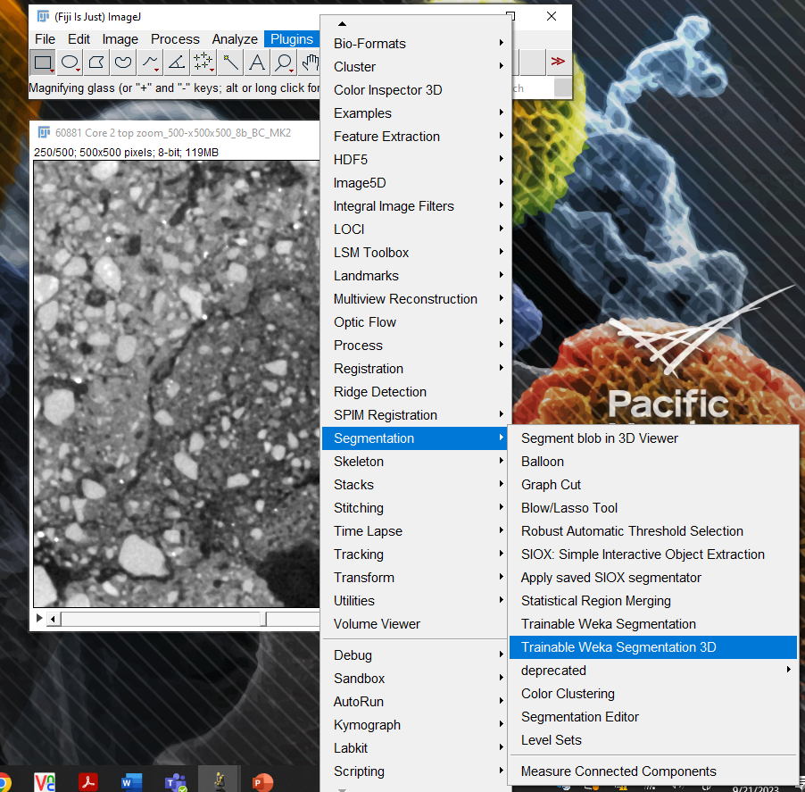
Segmentation – Trainable Weka Segmentation 3D plugin

Slide 13
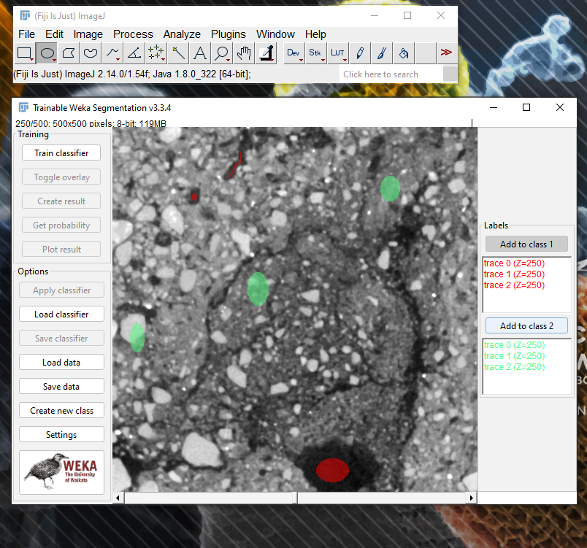
Segmentation – Annotate regions for pores (red) and soil matrix (green)

Slide 14
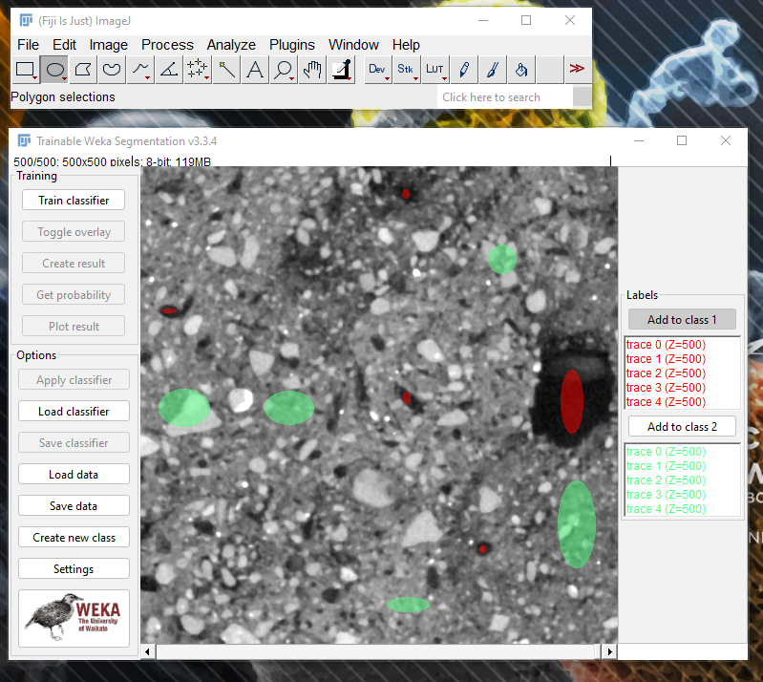
Segmentation – Do this classification for multiple slices (to create more training data)

Slide 15
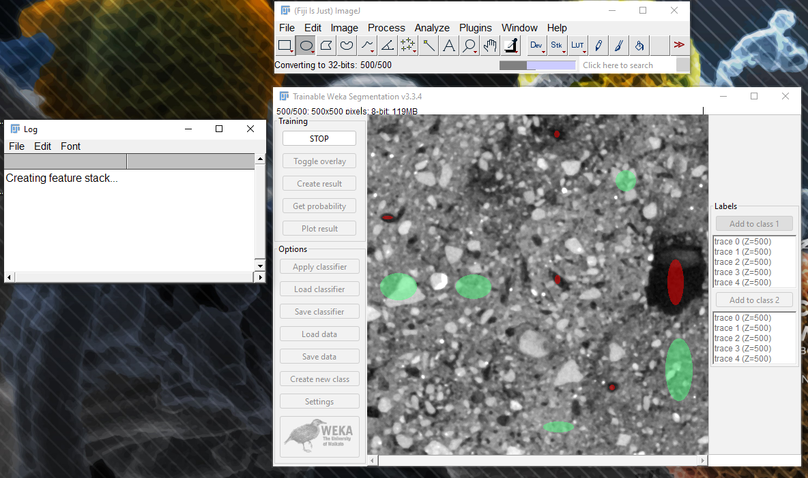
Segmentation – Train classifier (may take up to 30+ minutes)

Slide 16
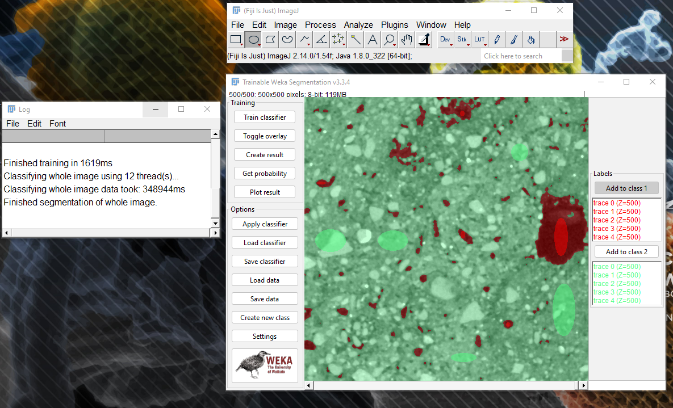
Segmentation – Create result from classified data (Classified image_500x500x500_RGB)

Slide 17
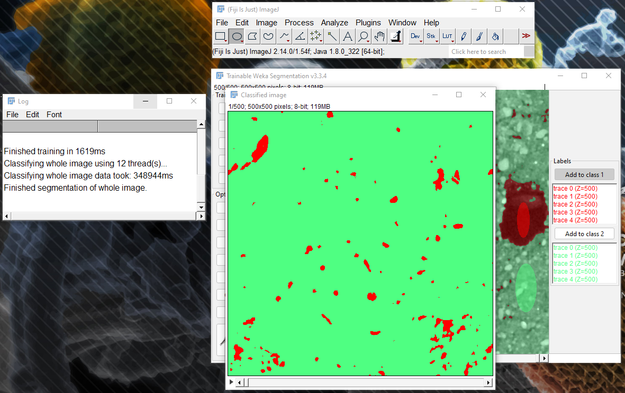
Segmentation – Create result from classified data – cont.

Slide 18
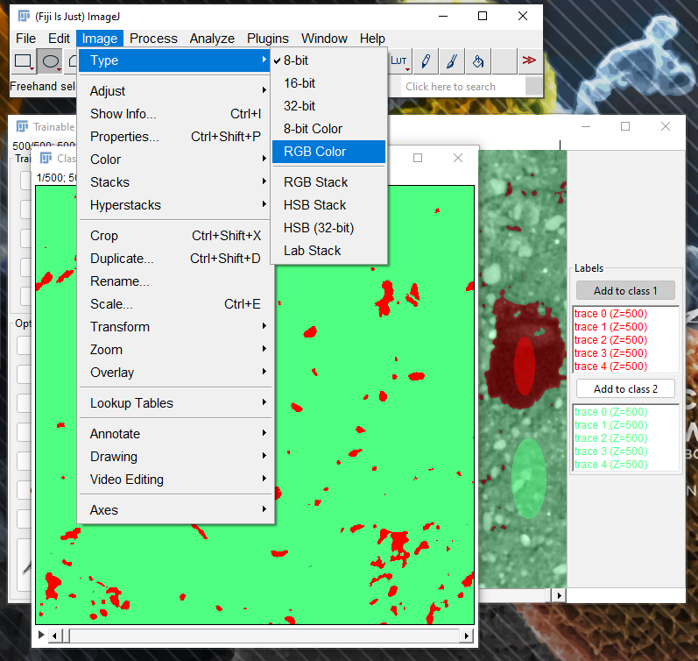
Segmentation – Convert segmentation result into RGB color data

Slide 19
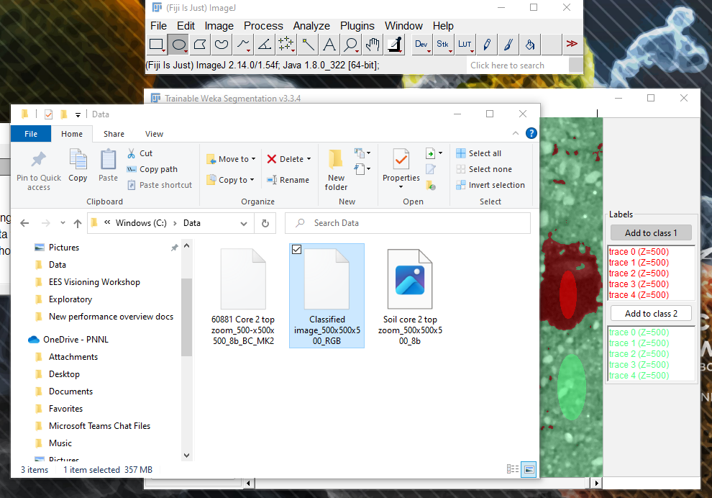
Segmentation – Save RGB color data as new raw file

Slide 20
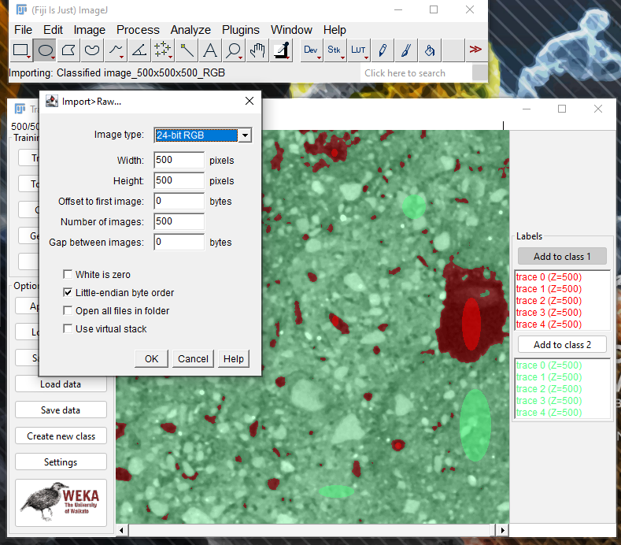
Segmentation – Open segmented (RGB) data as 24-bit RGB
File-Import-Raw-Select 24-bit RGB

Slide 21
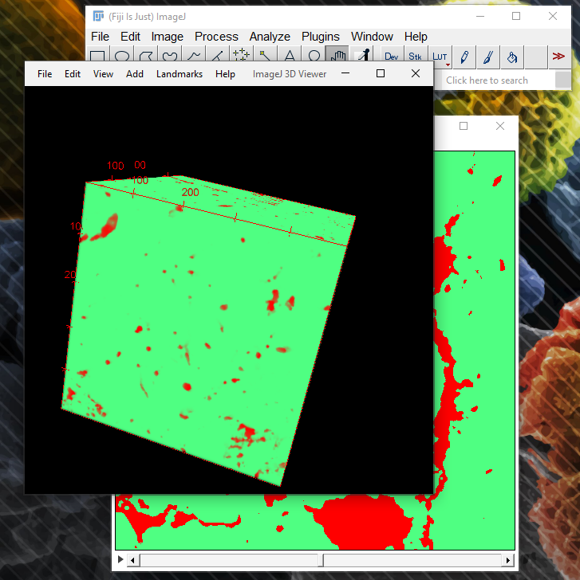
Visualization – The RGB data is not very useful for porosity visualization

Slide 22
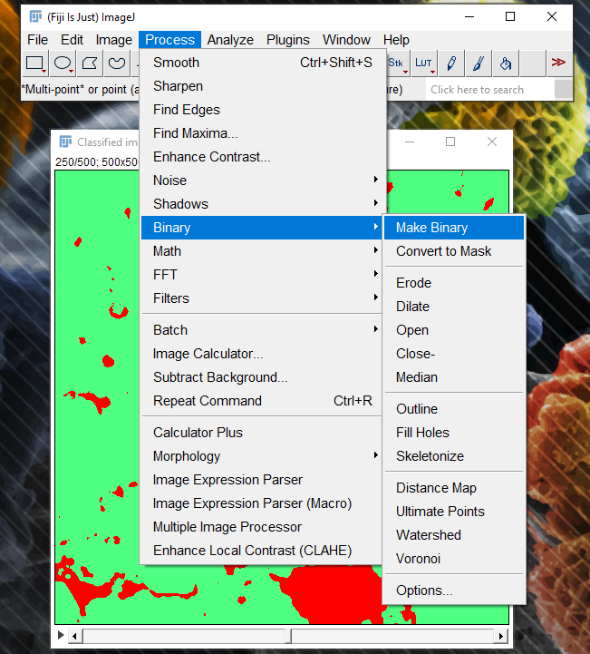
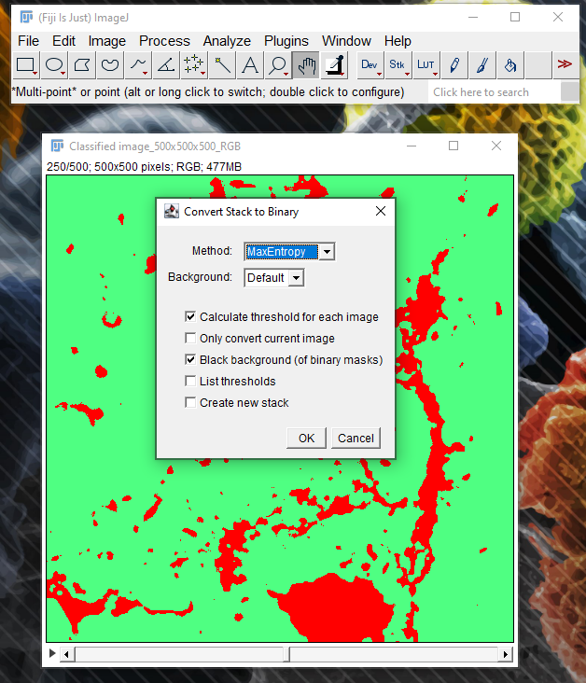
Visualization – Convert the RGB data into binary

Slide 23
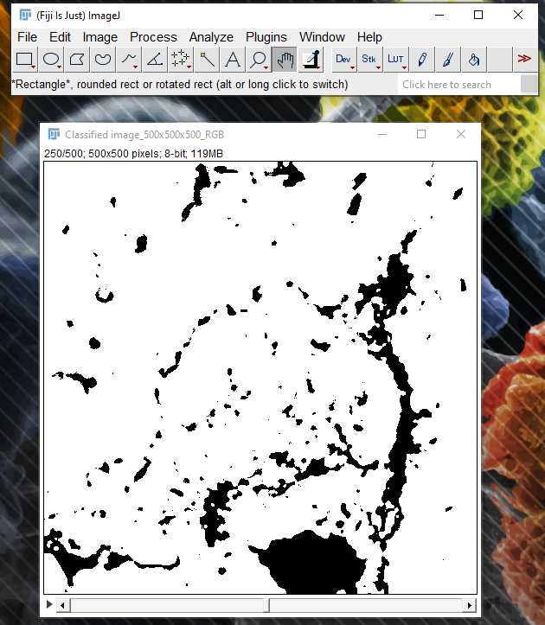
Visualization – Binarized data needs to be inverted (pores must be white)

Slide 24
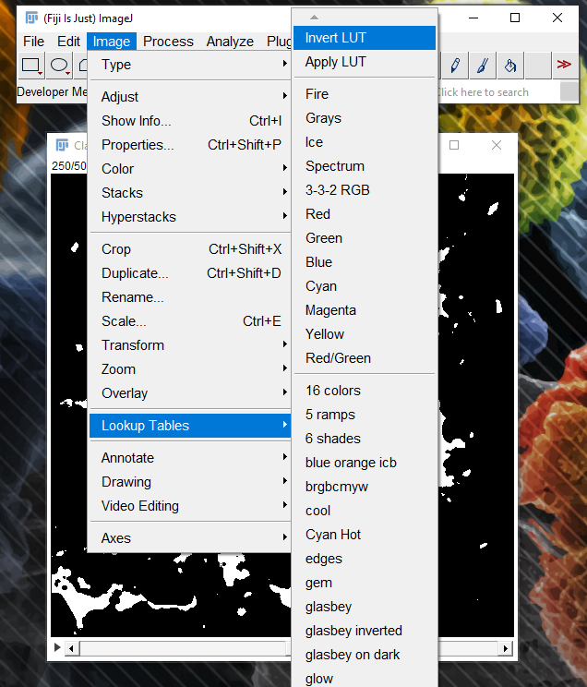
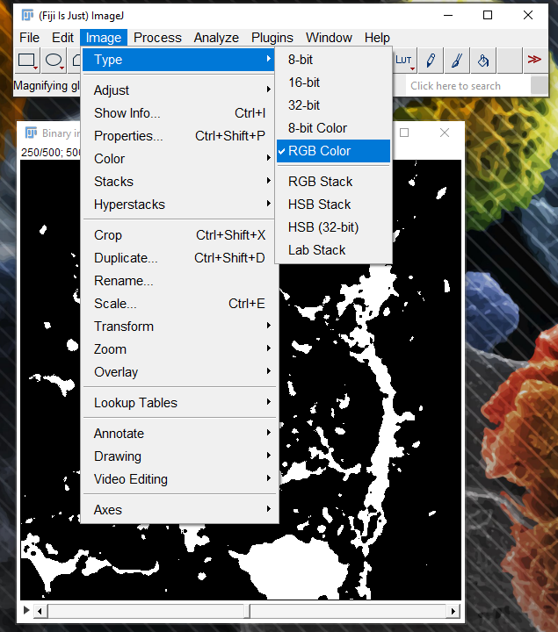
Visualization – Binarized data needs to be inverted (pores must be white)
Binarized data becomes 8-bit. It needs to be converted back to RGB so that it can be saved as inverted. The saved file can be opened again as 24-bit RGB and saved again as 8-bit.

Slide 25
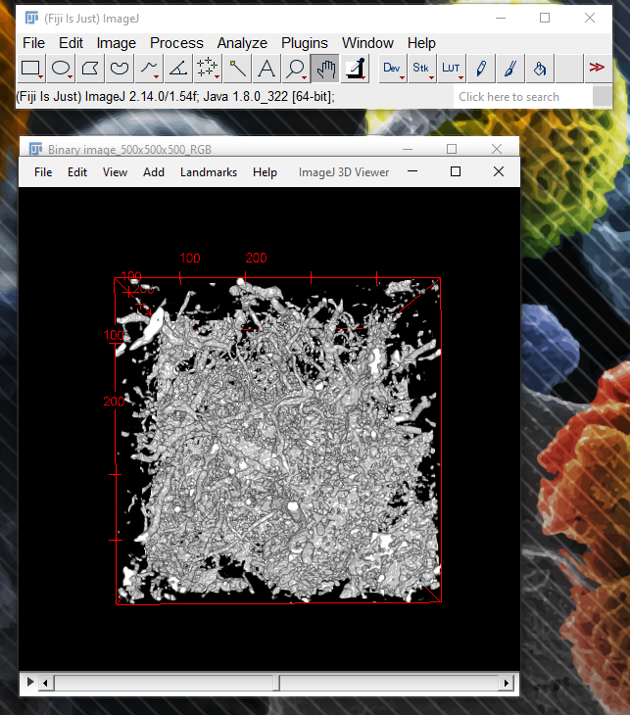
Visualization – Open 3D Viewer from Plugins to visualize the pore structure

Slide 26
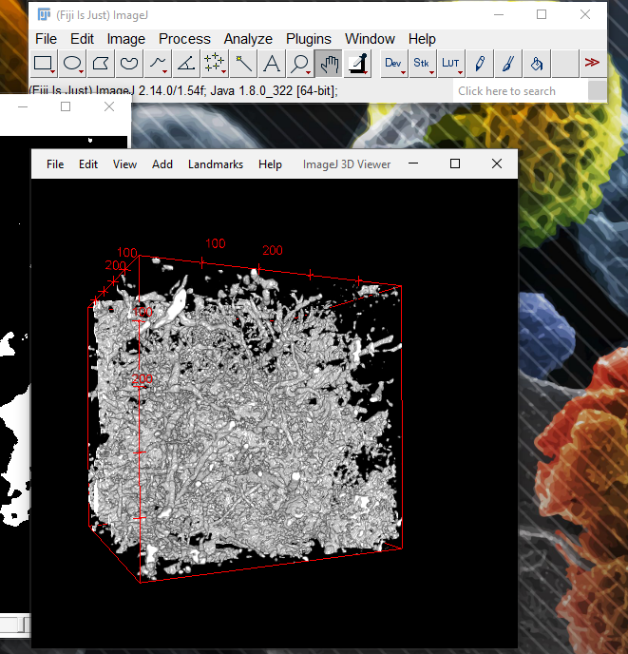
Visualization – Create an animation
- Click “Start animation” under “View”
- You can record a movie by clicking on “Record 360 deg rotation”

Slide 27
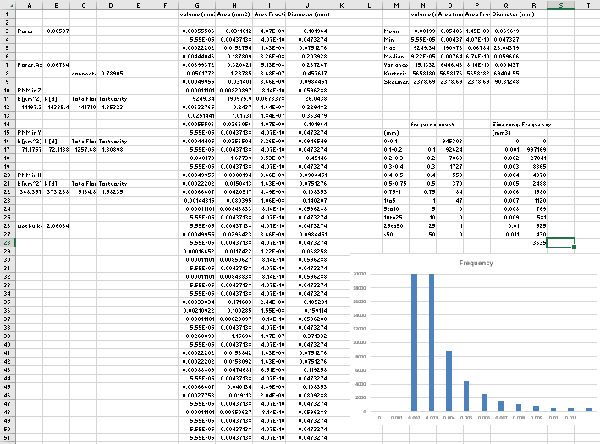
Analysis of porosity data in Excel
Open file: Example soil porosity data.xlsx

Slide 28
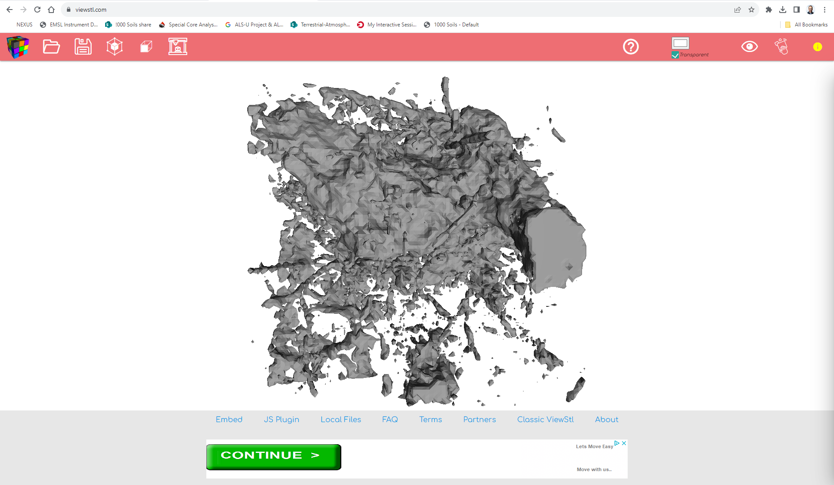
Using the porosity data: measurements, modeling
Volume analysis tools for pore network characterization (Avizo, ImageJ, Excel)
Conversion to STL format for visualization and modeling
Free STL viewer: https://www.viewstl.com/

Slide 29
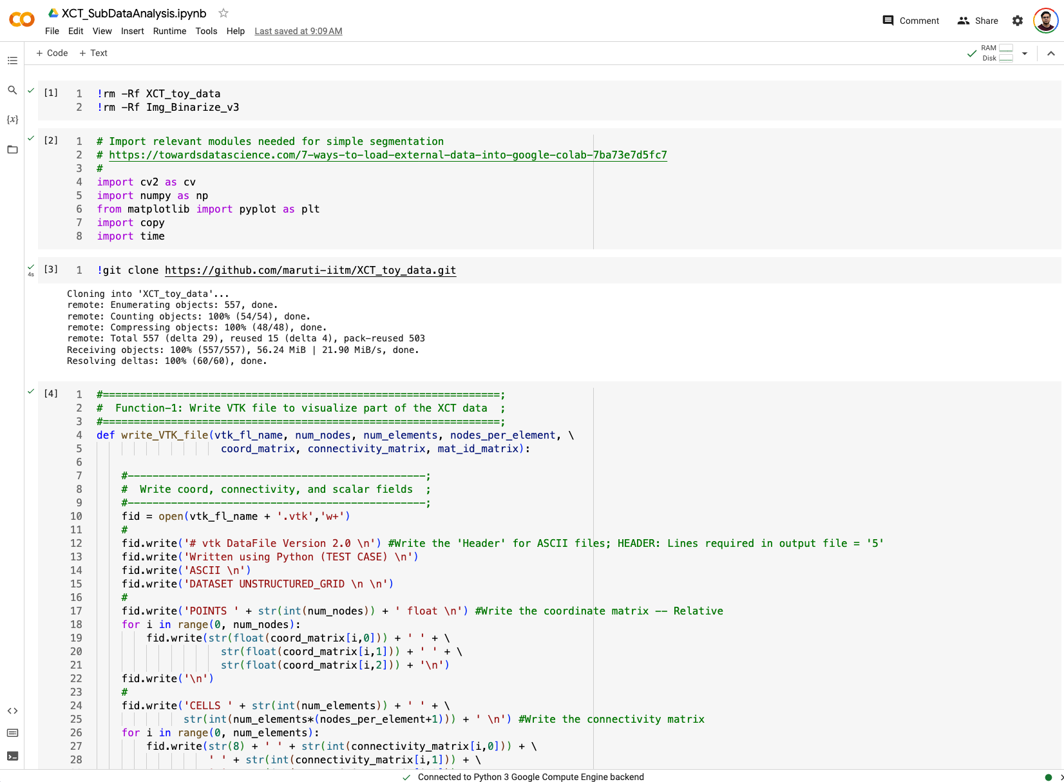
XCT data analysis – Google Colab Notebook

Slide 30
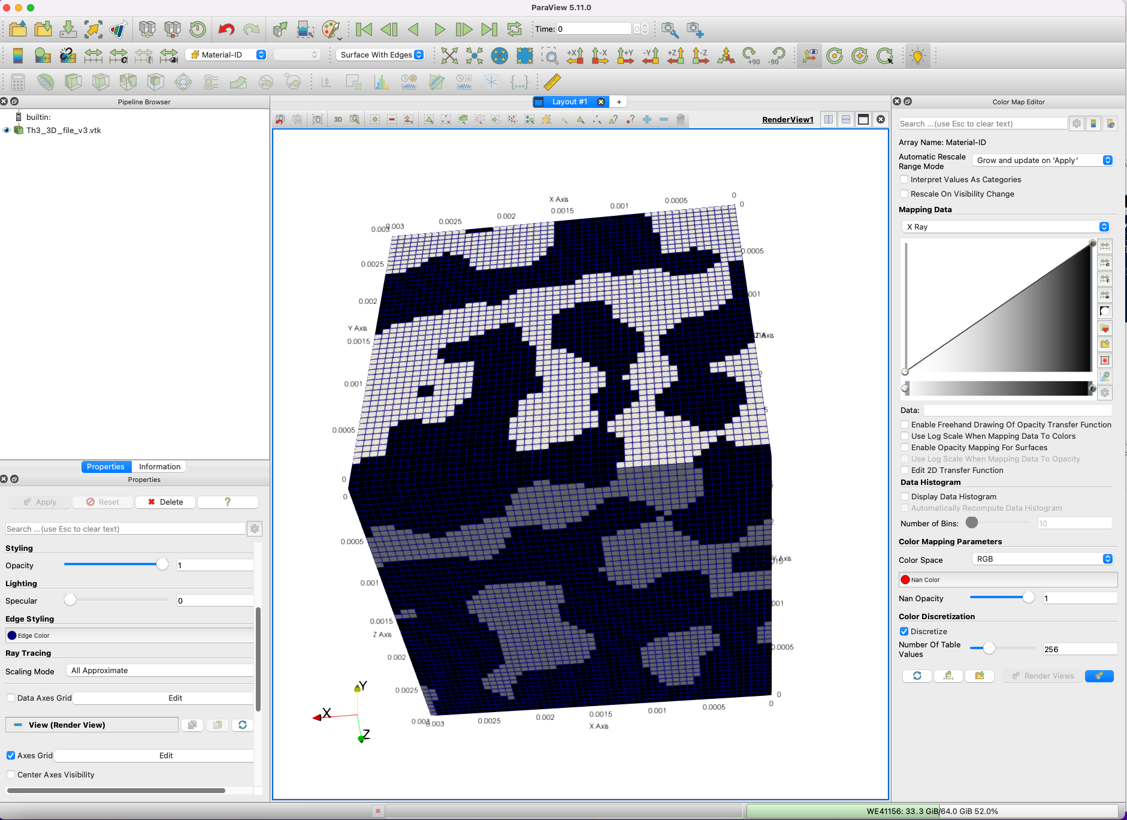
XCT segmented data visualization – ParaView (VTK files)

